Slide 1
The eponymous wines of Champagne carry a celebration in the mere mention of their name. For Champagne is the wine of joy par excellence. The wine that makes all people beautiful, a wine that epitomises the whole art of living.Furthermore there is no name that is more shamefully plagiarised around the world

Slide 2
HISTORY OF CHAMPAGNE
Situated at the “ Crossroads of Europe”
Roman colonisation and the introduction of the vine
Germanic invasions & its survival
The growth of the monasteries & the importance of wine in Christianity

Slide 3
HISTORY OF CHAMPAGNE
  The Abbey of Hautvilliers & Dom Perignon(1670-1715).The “ Father of Champagne” accredited with
  Blending different “cuvees”
  introducing corks that could withstand the pressure

Slide 4
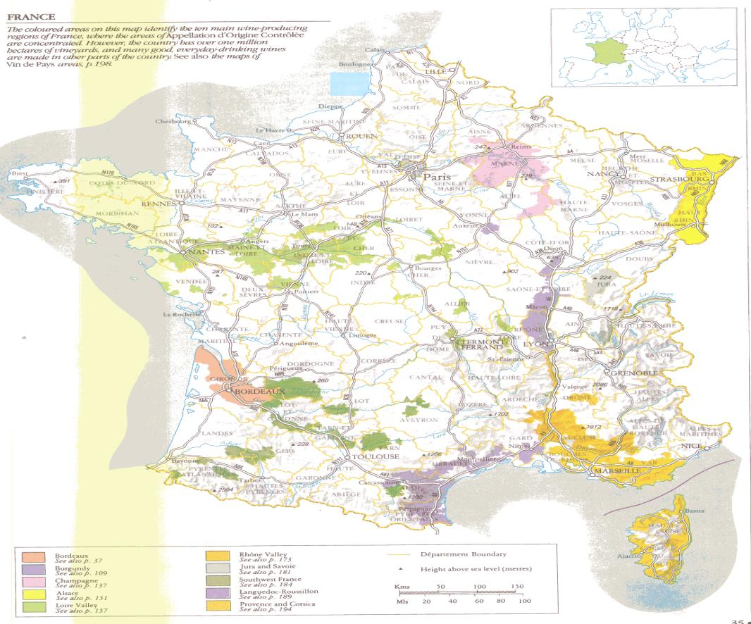

Slide 5
GEOGRAPHY OF CHAMPAGNE
Situated in North, Central France
  90 Km North-East of Paris & 300 Km from the coast
  Extends 180 Km from North to South & 120 Km from East to West

Slide 6
GEOGRAPHY OF CHAMPAGNE
Part of the northern-most wine growing belt of France
  very cold winters,summers are long & warm
  Frost in Spring
  Topography of low hills, forests to the east help moderate the extremes of temperature

Slide 7
GEOGRAPHY OF CHAMPAGNE
The Soil
  Chalky soils
  lends to the acidity in the wines
  the amount of chalk effects the quality of the crop & is considered in the grading process of the Vineyard

Slide 8
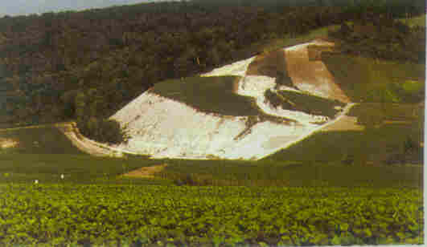
SOIL IN CHAMPAGNE

Slide 9
THE REGION
The 4 major districts are
  Montagne de Reims
  Valee de la Marne
  Cote de Blanc
  Aube

Slide 10
THE REGION
  These are centred around the shipper controlled towns of
  Reims
  Epernay
  Ay

Slide 11
GRAPE VARIETY
Pinot Noir
    Body & Strength(Montagne de Reims)
Pinot Meunier
    Freshness & Youth(Vallee de la Marne)
Chardonnay
    Elegance & Finesse (Cote de Blanc)

Slide 12
THE METHODE CHAMPENOISE
HARVESTING
  takes place usually in mid-September.
  Grapes are hand picked.
  attempt is to ensure the best quality of the “must”.

Slide 13
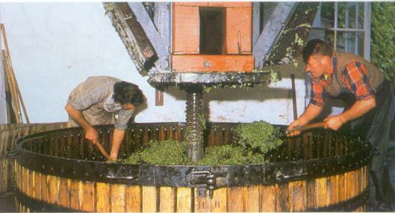
THE METHODE CHAMPENOISE
PRESSING
  uses the traditional basket press or the more modern pneumatic or bladder presses
  with stalks

Slide 14
THE METHODE CHAMPENOISE
  Quality & quantity of the “must” is controlled by the CIVC ( Comite Interprofessional du Vins de Champagne)
    each pressing gives a must used in the final blending
    4000 kg - 2666lts - 13 barrels – Vin de Cuvee
    Next 666 lts – Premier Taille
    Last press - Rebeche

Slide 15
THE METHODE CHAMPENOISE
Debourbage
  settling out of skin& yeast sediment at ambient cellar temperatures.
  can get better result at -5centigrade with bentonite.

Slide 16
THE METHODE CHAMPENOISE
The first fermentation
  vats are of premier importance-stainless steel ensures hygiene but Krug still uses oak
  Alcohol percentage goes upto 5-6 %

Slide 17
THE METHODE CHAMPENOISE
“ASSEMBLAGE”
This is a process of blending wines. About 40-45 wines can be blended together.
Ensures consistent quality ( proportion of previous wine used in the process)
The wine again undergoes cold stabilisation & is clarified & racked for the third time

Slide 18
THE METHODE CHAMPENOISE
“Liqueur de Tirage”
  a mixture of reserve wine,sugar & selected yeast culture
  used to engender a second alcoholic fermentation
  sugar, because the base wine is dry
  type & amount of yeast will vary according to the type of the champagne

Slide 19
THE METHODE CHAMPENOISE
Declaration of a Vintage
  conditions have been near perfect
  exceptional quality
  still a blend but only of the wines of that one year

Slide 20
THE METHODE CHAMPENOISE
Wine that is available at this stage is called”BOUZY ROUGE”
  sold in it’s own right
  used in the production of pink Champagne

Slide 21
THE METHODE CHAMPENOISE
THE SECOND FERMENTATION
( prise de mousse)
Bottling - The type of the bottle
  traditionally green
  glass is of greater thickness
  the “punt” at the base
  40 p.s.i.

Slide 22
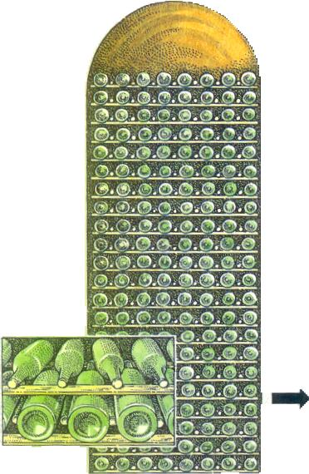

Slide 23
THE METHODE CHAMPENOISE
“Remouage”
  removal of the sediments of the secondary fermentation
  bottles transferred to racks called “ Pupitre”
  allows the movement of the bottles from a horizontal to a vertical position
  done by”remueurs”
  attributed to the Widow Cliquot c.1800

Slide 24
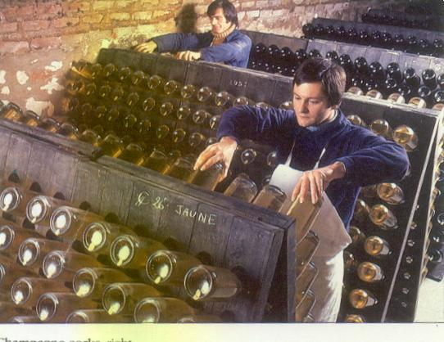

Slide 25
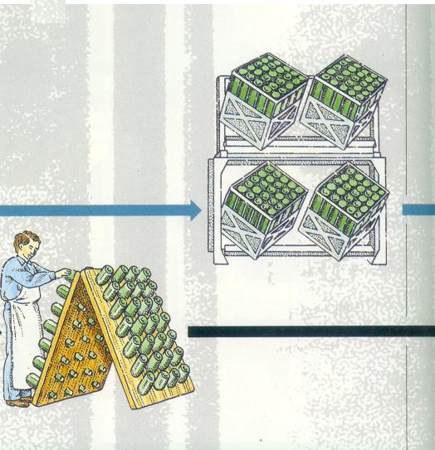

Slide 26
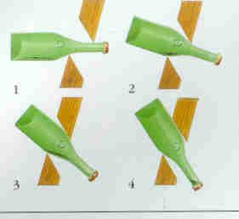

Slide 27
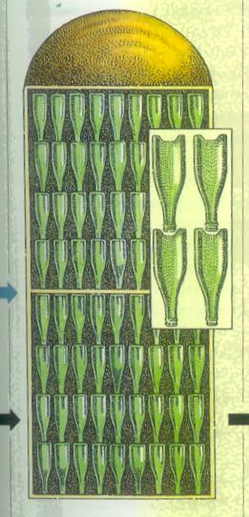
THE METHODE CHAMPENOISE
MATURING
  up to 5 years
  flavours enhanced by contact with the lees
  disgorgement delayed as long as possible

Slide 28
THE METHODE CHAMPENOISE
DISGORGING & DOSAGE
  undertaken by a “degorgeur”
  the neck of the bottle is immersed in chilled brine & the frozen plug removed by pressure
  Loss of liquid needs to be topped up.

Slide 29
THE METHODE CHAMPENOISE
  Acidity needs to be neutralised .
  Done with the “Liqueur d’expedition”(wine & sugar)
  Amount added is called the “ dosage”

Slide 30
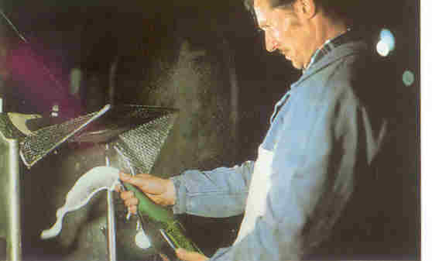

Slide 31
THE METHODE CHAMPENOISE
FINISHING
Corking
Shaking
Labeling

Slide 32
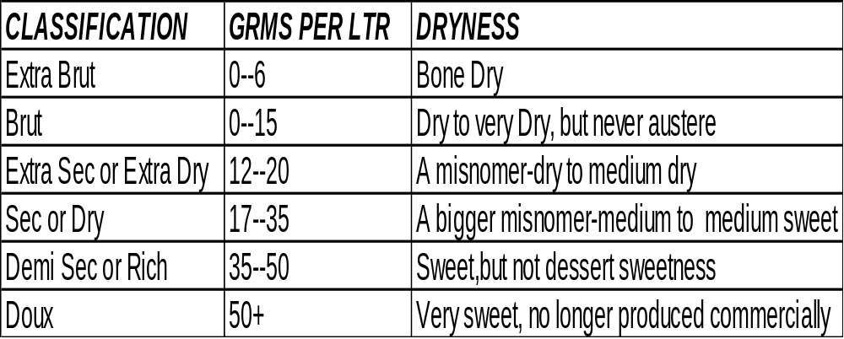
LEVELS OF SWEETNESS
Residual sugar measured in grams per litre

Slide 33
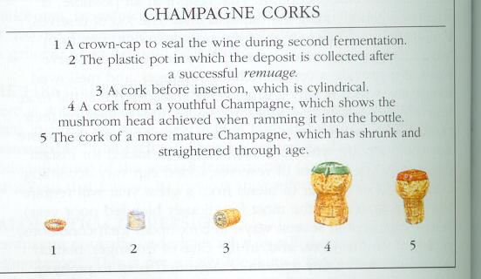
CHAMPAGNE CORKS

Slide 34
STYLES OF CHAMPAGNE
Luxury Cuvee- outstanding year, expensive
Vintage
Non Vintage
Pink

Slide 35
STYLES OF CHAMPAGNE
Blanc de Blanc
  “White of whites”
  Chardonnay
  Greatest Blanc de Noir potential
Cremant
Non Dosage or Extra Brut

Slide 36
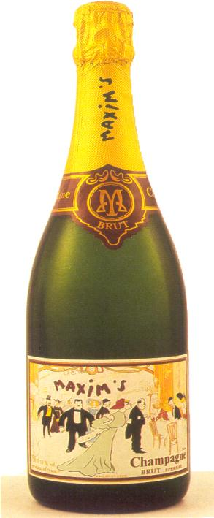
Buyers Own Brand
Coteaux Champagne

Slide 37
BOTTLE SIZES
Half ( a Flasher) 375 ml
Flasher 750ml
Magnum 750ml X 2
Jeroboam 750 X 4
Rehoboam 700 ml X 6
Methuselah 700ml X 8
Salemanezar 700ml X 12
Balthazar 700ml X 16
Nebuchadnezar 700ml X20

Slide 38
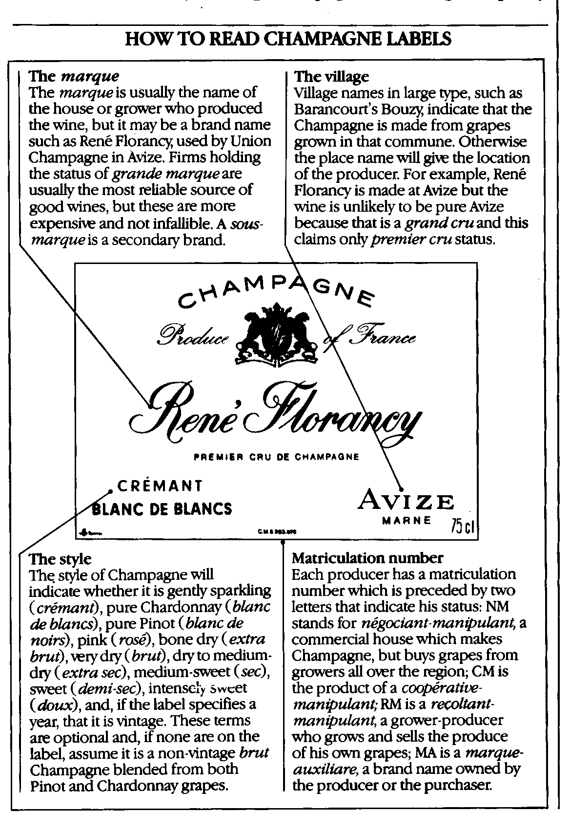

Slide 39
OTHER METHODS OF PRODUCING “THE SPARKLE”
Tank Method
    Secondary fermentation in a tank
    larger , shorter lived bubbles
    cheaper
Transfer
    secondary fermentation in the bottle, chilled, filtered, dosed & put back in the bottle
Impregnation

Slide 40
OTHER SPARKLING WINES
Spanish- Cava wines largest producers are Cordoniu & Friexenet
Italian- Asti Spumante
German Sekt
French Sparkling wines: Burgundy & Alsace make Cremants , also in the Loire Valley

Slide 41
SERVICE OF CHAMPAGNE
When…..For celebrations any time,as an aperitif, very occasionally with light meals,with dessert( sweet ‘demi-sec’ only)
How…..7 to 10 degrees centigrade for inexpensive types & up to 13 degrees for fine mature ones
……….In a tulip or a flute. Pour slowly into a slightly tilted glass

Slide 42
SERVICE OF CHAMPAGNE
How much…..3/4th of a glass
What to Look For……Plenty of pressure behind the cork, total clarity & indefinite “mousse”

Slide 43
CHAMPAGNE HOUSES
Krug
Piper Heidsieck
Moet et Chandon
Bollinger
Tattinger
Veuve Cliquot
Louis Roederer
G.H Mumm

